Slide 1
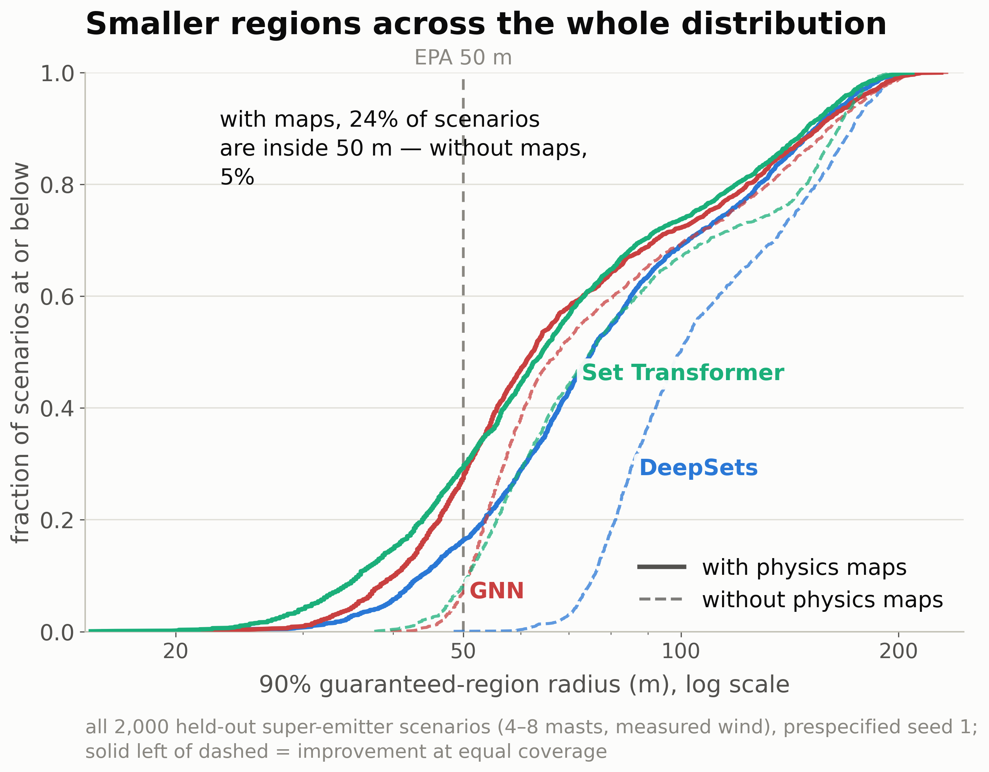
Physics-guided models (solid) sit left of their baselines (dashed) across the entire radius distribution, so the improvement covers easy and difficult scenarios alike. With the maps, 24% of scenarios reach the 50 m facility scale versus 5% without.

